Slide 1

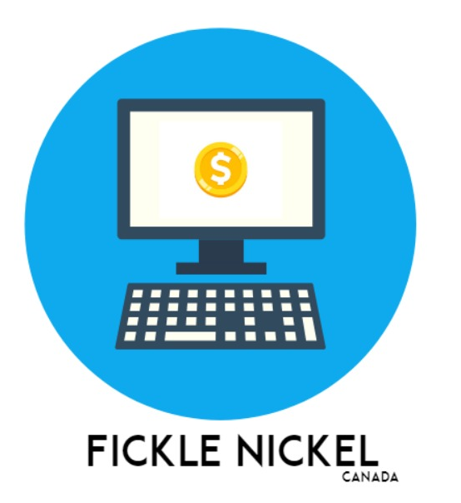
FICKLE NICKEL

Slide 2

AGENDA
Agenda
Team Structure
Problem Statement
Our Project
Market Overview
Target Customer
Major Features
Summary

Slide 3

PROBLEM
Problem
Information Overload
COST
Over 1 million financial documents are generated by companies across the globe for their shareholders.
The average cost for a financial advisor typically ranges from $150 to $350 per hour, varying based on the size of the investment.
inaccessibility
Time-Intensive process
Limited availability or difficulty in obtaining financial resources or advice.
It is a time-intensive process for manually analyzing financial data and seeking expert advice which can delay investment decisions.
Knowledge gap
Lack of sufficient understanding or expertise in financial matters

Slide 4

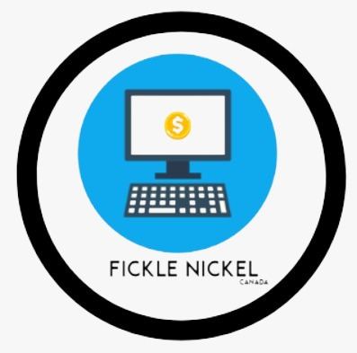




INVESTO:
A New Era of Financial Clarity……
Reliable
Affordable
SOTA AI & DS Methodologies
Meaningful Insights

Slide 5
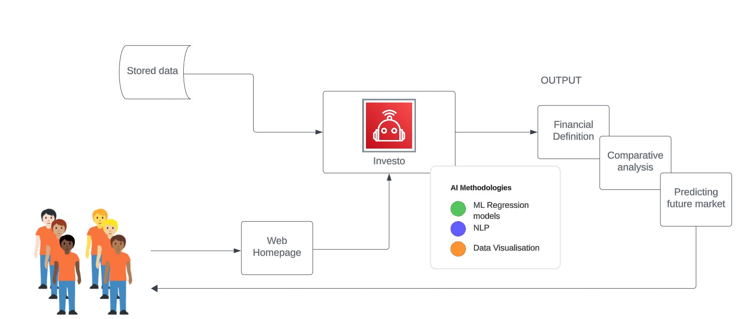
OUR PROJECT

Slide 6

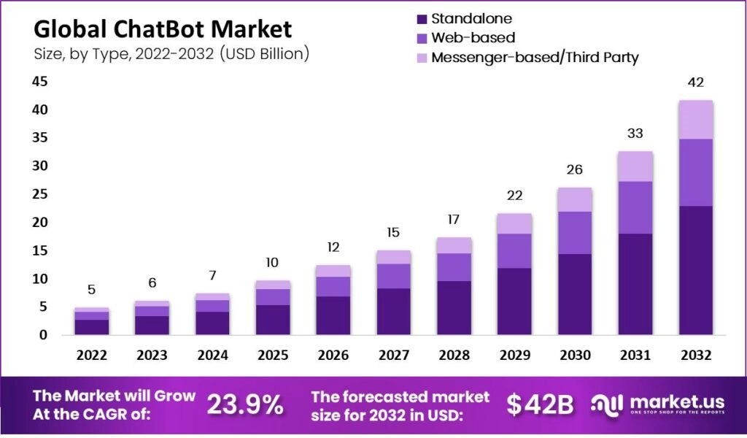
MARKET OVERVIEW

Slide 7
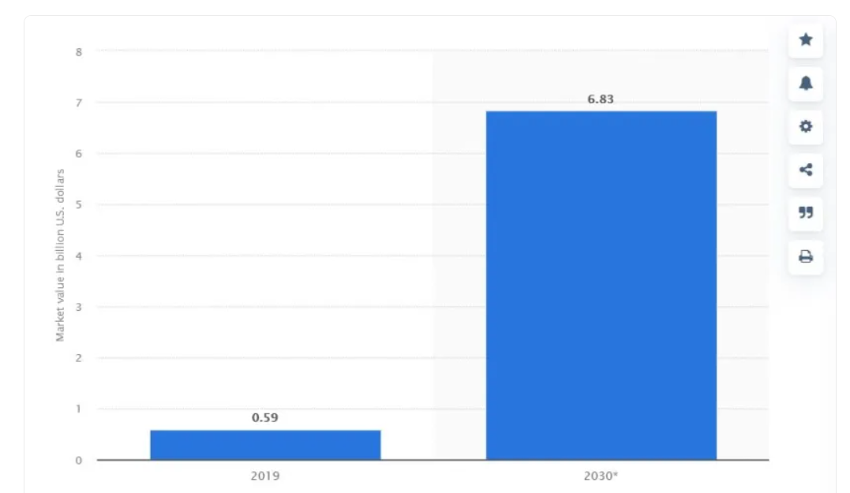
Financial Q&A Chatbot Market

Slide 8

TARGETING TOMORROW'S FINANCIAL VISIONARIES
Novices who wants to know about basic financial terms.
Seasoned investors who wants to make investments based on the financial reports of the organizations.
Someone who wants to make investments decisions on a comparative basis on different companies of the same sector.
Customers

Slide 9
Why they are our target customer
According to CityNews Toronto (2022), seven out of 10 Canadians consider themselves to be financially literate, while close to 30 percent don’t consider themselves to be in that category, according to a new poll.
According to investopedia (2021), most of the financial reports are typically in the range of $5 to $50.

Slide 10

Major features
Financial Forecasting
Both Visual and numeric representation
Comparison between multiple companies

Slide 11

Empowering Consumers: Unlocking The Benefits Of Investo
Financial Literacy
Insights
Advanced Technology
Our consumers be able to access timely target information & intelligence about the finance market.
Our consumers will be able to make informed financial decisions with the help of our prediction model.
Our consumers will be able to become more finance -knowledgeable.

Slide 12

SUMMARY
With our chatbot, investors will develop enhanced financial decision-making capabilities. As Warren Buffett famously said, ‘Risk comes from not knowing what you're doing’ Our platform minimizes this risk by providing accurate, timely, and personalized financial insights.
summary

Slide 13
References
Market Cap explained (2022) FINRA.org. Available at: https://www.finra.org/investors/insights/marketcap#:~:text=Market%20capitalization%2C%20or%20market%20cap,by%20company %20officers%20and%20insiders (Accessed: 09 February 2024).
Chopra, H. (2023) Revenue: Definition, types and examples | indeed.com, Indeed. Available at: https://www.indeed.com/career-advice/career-development/revenuedefinition (Accessed: 09 February 2024).
(2023) Gross profit: Definition and how to calculate it | indeed.com. Available at: https://www.indeed.com/career-advice/career-development/gross-profit-definitionand-how-to-calculate-it (Accessed: 10 February 2024).
Kenton, W. (2023) Net income (NI) definition: Uses, and how to calculate it, Investopedia. Available at: https://www.investopedia.com/terms/n/netincome.asp (Accessed: 10 February 2024).
Earnings per share (EPS) (no date) What is Earnings Per Share (EPS)? Calculation & Limitation. Available at: https://www.td.com/ca/en/investing/directinvesting/articles/eps (Accessed: 10 February 2024).
Square (no date) An explanation of EBITDA and why it matters, Square. Available at: https://squareup.com/gb/en/glossary/ebitda#:~:text=EBITDA%20stands%20for%20’ Earnings%20Before,of%20non%2Dcore%20financial%20expenses (Accessed: 10 February 2024).

Slide 14
Hayes, A. (2023) What is shareholder equity (SE) and how is it calculated?, Investopedia. Available at: https://www.investopedia.com/terms/s/shareholdersequity.asp (Accessed: 10 February 2024).
CFI Team (2023) Cash flow from operations, Corporate Finance Institute. Available at: https://corporatefinanceinstitute.com/resources/accounting/cash-flow-fromoperations/ (Accessed: 10 February 2024).
Seth, S. (2023) Cash flow from operating activities (CFO) defined, with formulas, Investopedia. Available at: https://www.investopedia.com/terms/c/cash-flow-fromoperating-activities.asp (Accessed: 10 February 2024).
Jirav, J. (2023) Cash flow from investing: Definition & Formula: Jirav, Jirav Business Planning, FP&A, and Forecasting Software. Available at: https://www.jirav.com/standard-metrics-library/investing-cash-flow (Accessed: 10 February 2024).
Murphy, C.B. (2022) Cash flow from Financing Activities (CFF) Formula & Calculations, Investopedia. Available at: https://www.investopedia.com/terms/c/cashflowfromfinancing.asp#:~:text=Cash%20f low%20from%20financing%20activities%20(CFF)%20is%20a%20section%20of,deb t%2C%20equity%2C%20and%20dividends. (Accessed: 10 February 2024).
Indeed Editorial Team (2022) What is current ratio? definition and examples | indeed.com. Available at: https://www.indeed.com/career-advice/careerdevelopment/current-ratio (Accessed: 10 February 2024).
Fernando, J. (2023) Debt-to-equity (D/E) ratio formula and how to interpret it, Investopedia. Available at: https://www.investopedia.com/terms/d/debtequityratio.asp (Accessed: 10 February 2024).

Slide 15
Fernando, J. (2024) Return on equity (ROE) calculation and what it means, Investopedia. Available at: https://www.investopedia.com/terms/r/returnonequity.asp (Accessed: 10 February 2024).
Hargrave, M. (2024) Return on assets (ROA): Formula and ‘good’ roa defined, Investopedia. Available at: https://www.investopedia.com/terms/r/returnonassets.asp#:~:text=Return%20on%20a ssets%20is%20a,income%20by%20its%20total%20assets. (Accessed: 10 February 2024).
Fernando, J. (2023, December 22). Return on Investment (ROI): How to Calculate It and What It Means. Investopedia. https://www.investopedia.com/terms/r/returnoninvestment.asp
Murphy, C. (2022, March 6). How to Calculate Net Profit Margin. Investopedia. https://www.investopedia.com/terms/n/net_margin.asp#:~:text=The%20net%20profit %20margin%2C%20or
Free Cash Flow Per Share: Meaning and Calculations. (n.d.). Investopedia. https://www.investopedia.com/terms/f/freecashflowpershare.asp#:~:text=Free%20cas h%20flow%20per%20share%20(FCF)%20is%20a%20measure%20of
Wall Street Prep. (2023). Return on Tangible Equity (ROTE). [online] Available at: https://www.wallstreetprep.com/knowledge/return-on-tangible-equity-rote/ [Accessed 10 Feb. 2024]
PitcBond, M. (2022) Majority of Canadians consider themselves financially literate: Poll, CityNews Toronto. Available at: https://toronto.citynews.ca/2022/11/04/financially-literate-canada-poll/ (Accessed: 12 March 2024).

Slide 16
Team, T.I. (2021) Data mining for investors, Investopedia. Available at: https://www.investopedia.com/articles/basics/03/053003.asp#:~:text=You%20can%20buy%20these%20reports,Finance.&text=Many%20different%20websites%20will%20offer,or%20on%20a%20subscription%20basis. (Accessed: 12 March 2024).
Pitch deckDilmegani, C. (2024, February 5). Top 8 Finance Chatbot Use Cases & Applications in 2024. AIMultiple Research. https://research.aimultiple.com/finance-chatbot/
Team, P. E. (2024, March 20). 7 best finance chatbots to boost your ROI in 2024. Chat Blog. https://www.proprofschat.com/blog/finance-chatbots/
Dilmegani, C. (2024b, February 22). Chatbot pricing: How much different chatbots cost in 2024?. AIMultiple. https://research.aimultiple.com/chatbot-pricing/
The long-term perspective on markets. Macrotrends. (n.d.). https://www.macrotrends.net/

Slide 17
WIX WEBSITE & Chatbot
https://jashanpreetkaurjee.wixsite.com/fickle-nickle
https://finappchatbot-investo.streamlit.app/

Slide 18

THANK YOU!! Q&A

